Slide 1
COVID-19: PREDICTION OF THE HOSPITALIZATION RATE
Statistisches Praktikum
WiSe21/22
16.03.2022
Munich
Group:
Alexander Marquard
Phu Nguyen
Qian Feng
Project partner:
Yeganeh Khazaei
Statistisches Beratungslabor StaBLab der LMU
Institut für Statistik

Slide 2
AGENDA
01
02
Background Information
Data Processing
Data Analysis
03
04
Model Introduction
Discussion
05
2

Slide 3
01
BACKGROUND INFORMATION
3

Slide 4
BACKGROUND INFORMATION
Background:
Meaningful evaluations of the data base and determination of measures (such as the reproduction number, incidence, or hospitalization incidence) serve as guiding criteria for measures against the further spread of the virus.
Task at hand:
Predict hospitalization rate one to two weeks in the future, taking into account both time and geographical factors.
4

Slide 5
DEFINITIONS
HOSPITALIZATION (RATE)
The number of COVID-19 patients admitted for treatment (per 100,000 population) in a given time period.
formula

Slide 6
DEFINITIONS
NOWCASTING
Problem: Delays in reporting (period between onset of illness and reporting).
New hospitalizations being reported daily do not reflect actual numbers
Nowcast: An estimate is provided at the current point in time by using a statistical procedure

Slide 7

DEFINITIONS
DELAYED REPORTS
 | Reported | Updated
01.08.2021 | 407 | 756
02.08.2021 | 416 | 786
407
416
Notes:
6.5

Slide 8
TYPICAL COVID-19 PROGRESSION
Latency period (non-contagious): Ø 2.5 Days
Ø 4 Days
04
Incubation period: Ø 5 – 6 Days
First symptoms
Hospitalization of a severe case
Infected
Contagious
5

Slide 9
BUREAUCRATIC REPORTING PROCESS OF A COVID-19 CASE
Reported at the local health department
First symptoms
Reported at the RKI
Hospitalization of a severe case
Tested positive
Reported date
Hospitalized date
5

Slide 10
WHAT IS ACTUALLY PREDICTED THEN?
The updated hospitalization rate
on the reported date of infection
for the next two weeks
4

Slide 11
02
DATA PROCESSING

Slide 12
DATA COLLECTION
From the RKI:
Neuerkrankung
Hospitalisierung
From the KITMetricslab:
Population
Data on the COVID-19 vaccination rate
Conflicts with other data sets:
Age groups on the Impfquote data set:
„05-11“, „12-17“, „18-59“, „60+“
Age groups on the Neuerkrankung and Hospitalisierung data sets :
„00-04“, „05-14“, „15-34“, „35-59“, „60-79“, „80+“
4

Slide 13
FINALIZED DATA SET
Meldedatum | Kalenderjahr | Kalenderwoche | Index | Bundesland | Altersgruppe | Population | Neuerkrankung | Hospitalisierung
2020-03-01 | 2020 | 9 | 9 | Bayern | 80+ | 871866 | 0 | 0
2020-03-08 | 2020 | 10 | 10 | Bayern | 80+ | 871866 | 3 | 2
2020-03-15 | 2020 | 11 | 11 | Bayern | 80+ | 871866 | 39 | 25
2020-03-22 | 2020 | 12 | 12 | Bayern | 80+ | 871866 | 214 | 132
2020-03-29 | 2020 | 13 | 13 | Bayern | 80+ | 871866 | 759 | 383
7

Slide 14
03
DATA ANALYSIS

Slide 15


PROBLEMS
Berlin
Brandenburg
4

Slide 16
PROBLEMS
 | Neuerkrankung | Hospitalisierung
Berlin | 1 | 0
Brandenburg | 0 | 1
4

Slide 17
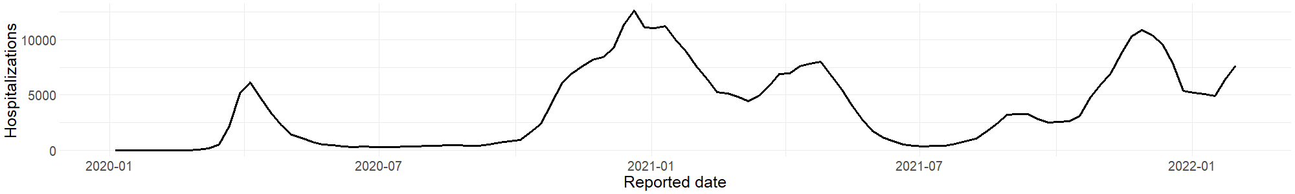
POSSIBLE INTERPRETATIONS OF „HOSPITALIZATION RATE“
Absolute numbers
13
Notes:
Standard

Slide 18
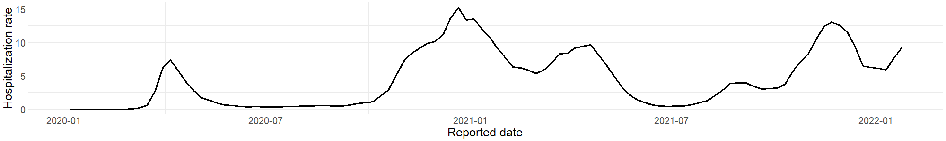
Hospitalizationrate as reported (RKI)
13
Notes:
Standard

Slide 19
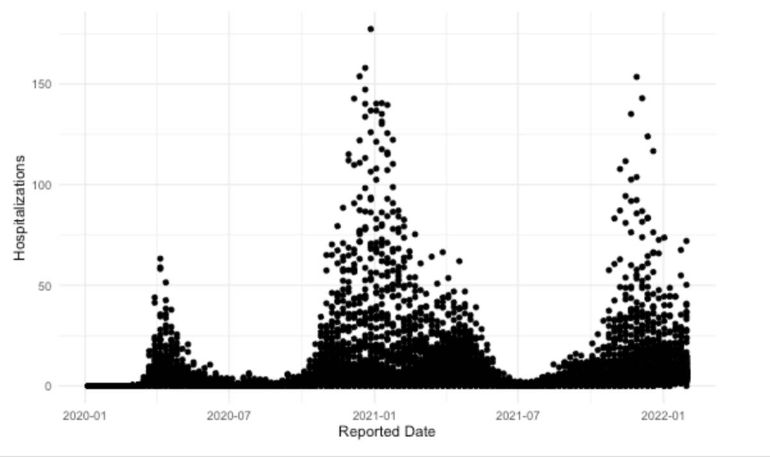
Explaining the Hospitalization
13
Notes:
Standard

Slide 20
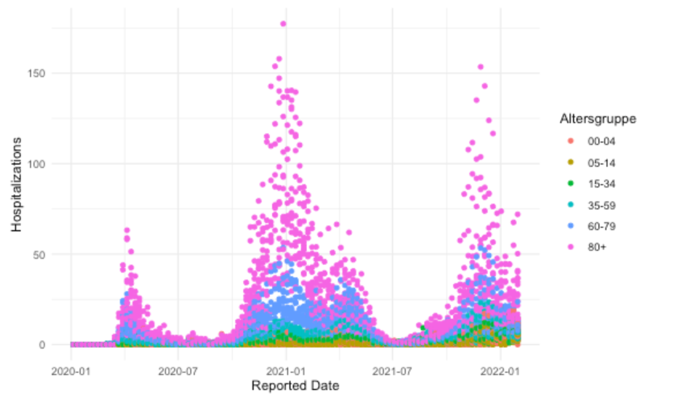
Explaining the Hospitalization (breaks down naturally)
13
Notes:
Zerfällt natürlich in einzelne kohorten

Slide 21
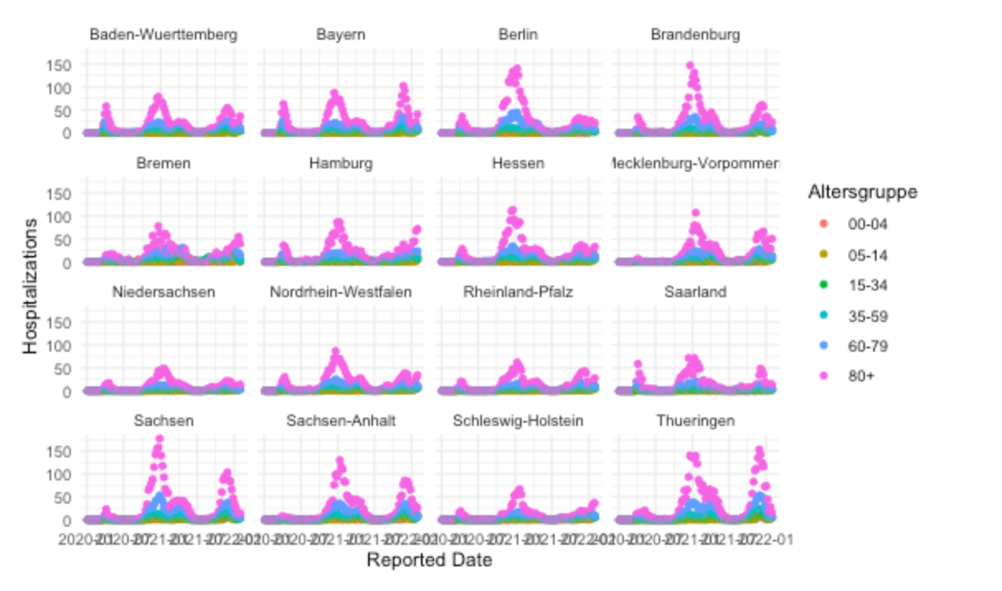
Explaining the Hospitalization
13
Notes:
Weiterer zerfall. Nurnoch eine beobachtung zu jedem zeitpunkt

Slide 22
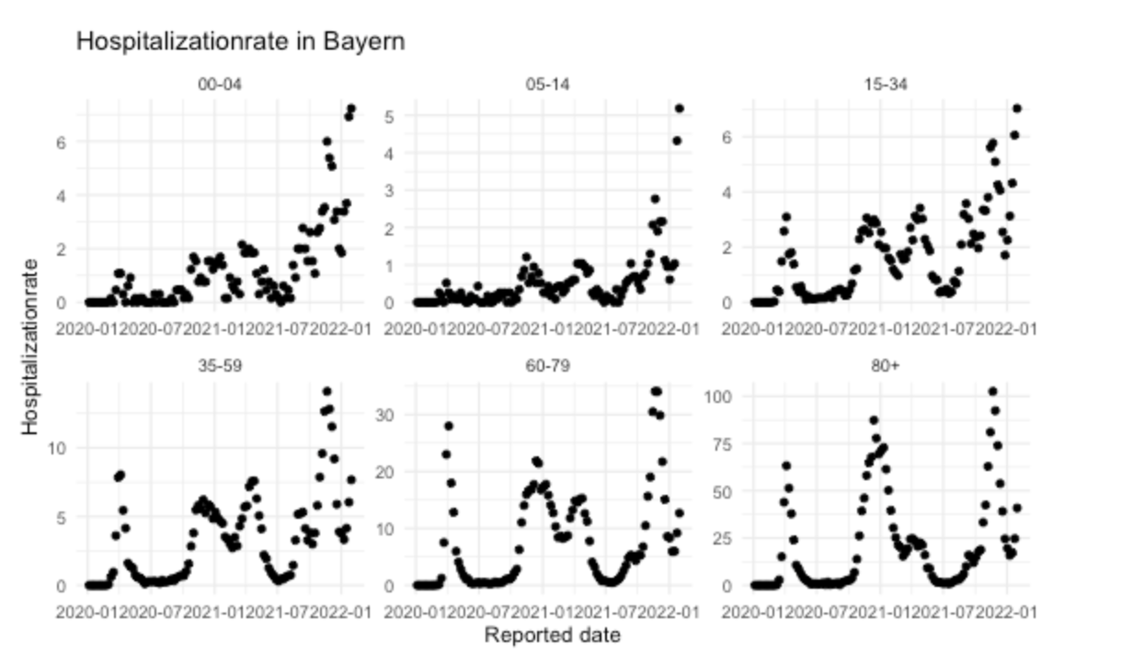
Explaining the Hospitalization
13
Notes:
Betrachtung von Bayern als Beispiel

Slide 23
Analyzing individual states using GAM (Bayern)
Distributionassumption:
Hospitalization_i|x_i ~ Poi(lambda)
E(Hospitalization_i) = b0 + Agegroups_i + f(index_i)
Link:
Logit
Effect of the individual coefficients:
Intercept: exp(1.06) ~ 3
05-14: Exp(-0.03) ~ 1
15-34: exp(1.93) ~ 7
35-59: exp(2.77) ~ 16
60-79: exp(2.58) ~ 13
80+: exp(2.3) ~ 10
The age groups 00-04 and 05-14 are the least impactful agegroups.
This holds true for each individual state
15
Notes:
Coefficients: Estimate Std. Error t value Pr(>|t|) (Intercept) -1.83770 0.15982 -11.499 < 2e-16 *** Altersgruppe(59, Inf) 1.66400 0.06008 27.698 < 2e-16 *** seasonAutumn -0.11828 0.08151 -1.451 0.14855 seasonSpring 0.23664 0.08079 2.929 0.00387 ** seasonWinter 0.09325 0.10207 0.914 0.36223 log(lag_1) 1.37197 0.05791 23.692 < 2e-16 *** log(lag_2) -0.57622 0.05312 -10.847 < 2e-16 ***

Slide 24
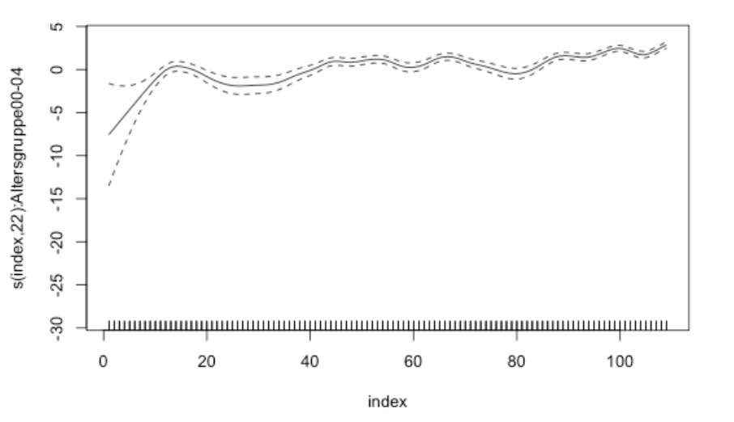
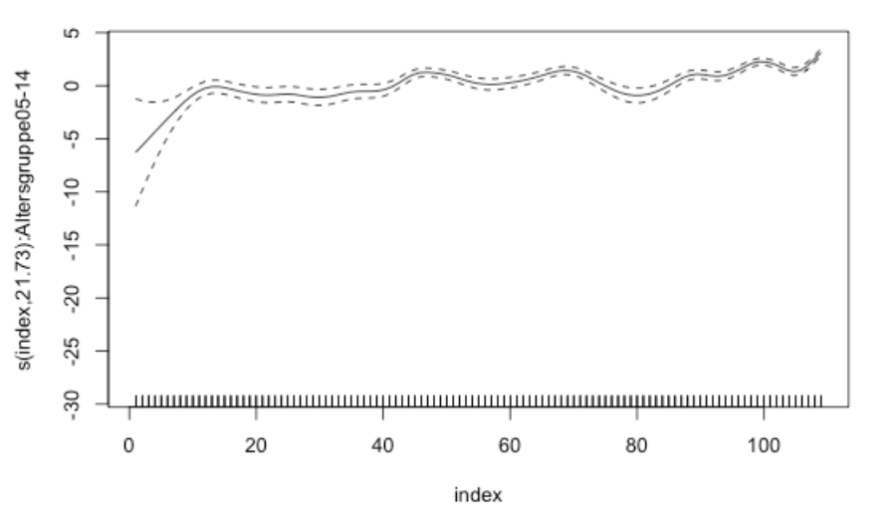
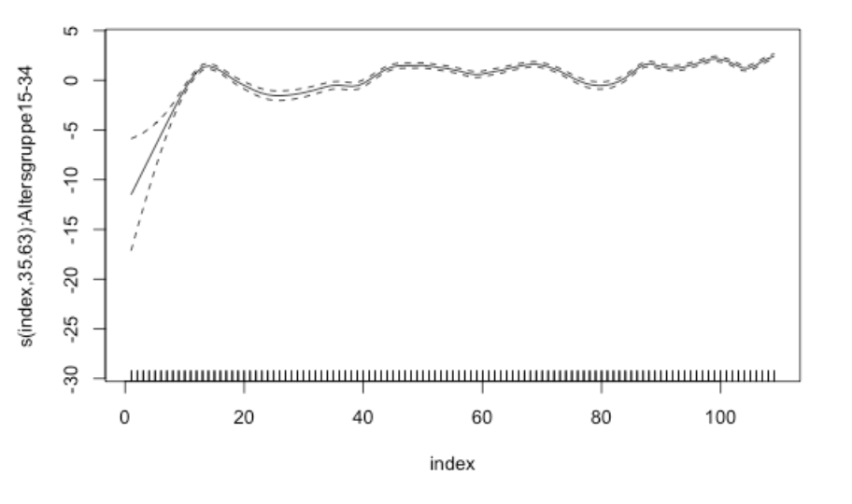
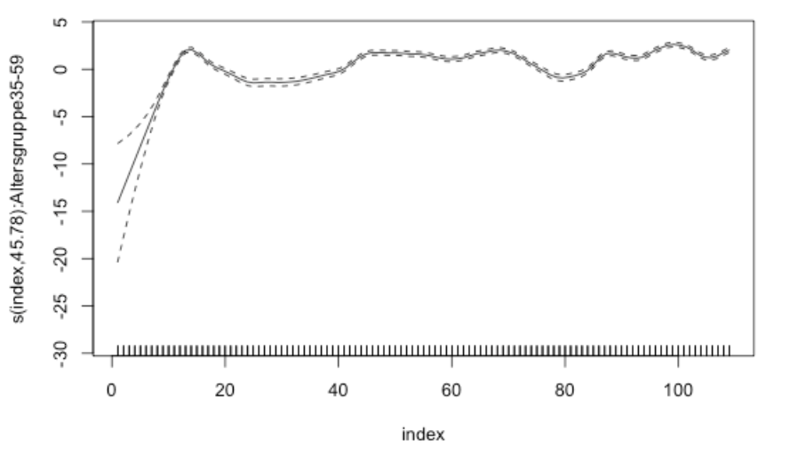
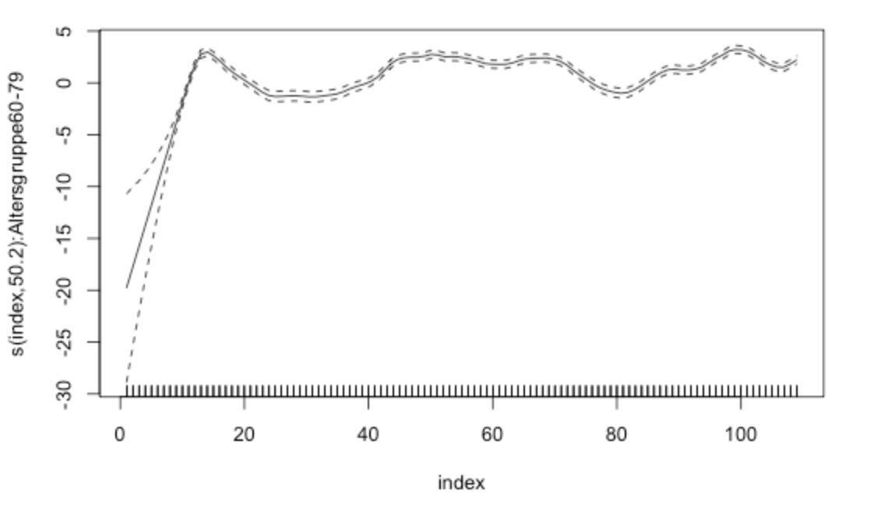
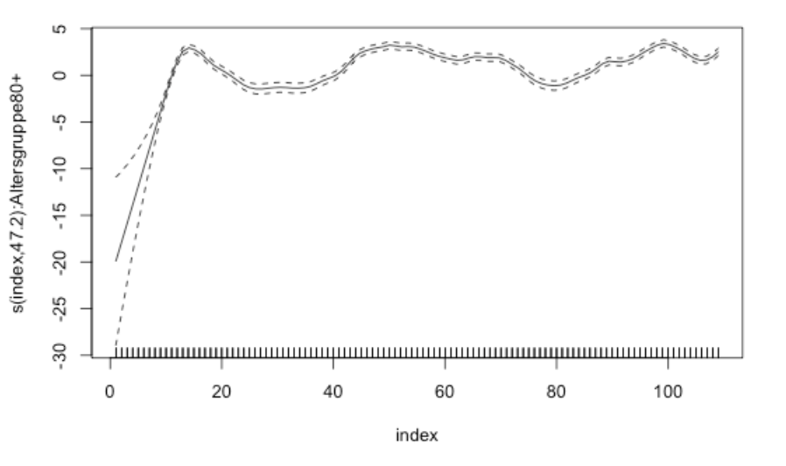
Analyzing individual states using GAM (Bayern)
The effect of the timevarying covariable given the age groups stays nearly the same for each age group.
This holds true for each individual state
15
Notes:
Interpretation:
In den ersten kalenderwochen steigt die zahl der hospitalisierungen stark an -> begin der pandemie (klar).
Anschließend schwankt der trend um die 0, im zeitlichen verlauf ist jedoch ein schwacher steigender trend zu beobachten

Slide 25
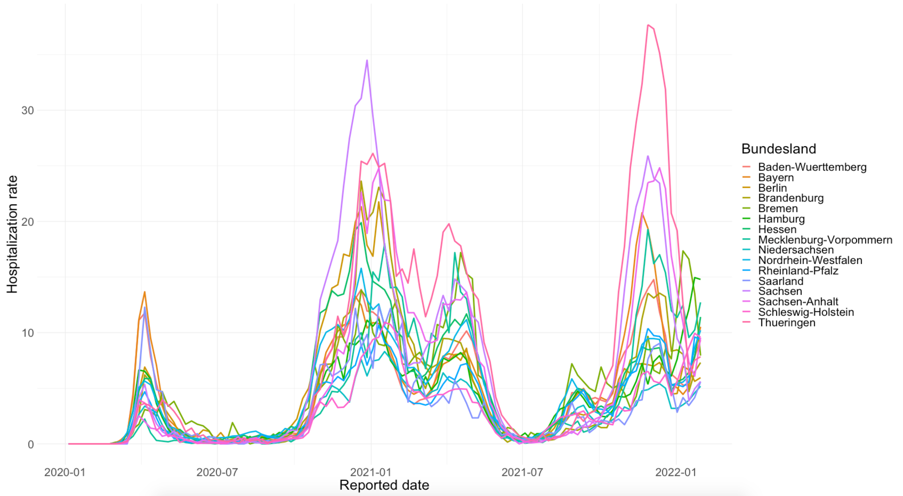
HOSPITALIZATION RATE BY STATE
13
Notes:
Hier normierung auf die population um effekte des trends zu beobachten
Der trend für jedes Bundesland ist unterschiedlich stark
Insgesamt ein steigender trend zu beobachten

Slide 26
Conclusion
Differentiating between states seems profitable in order to increase the prediction, due to quite different trends in the individual states
The Trend for each age group regarding the hospitalization looks quite similar
13

Slide 27
04
Exkurs: Time Series

Slide 28
Time Series
Time series´s can have different properties
Stationarity
Does the time series show a clear trend or is it stable over
The course of time
Seasonality
Is there a seasonal pattern? Such as the time of the year
Or the day of the week?
15

Slide 29
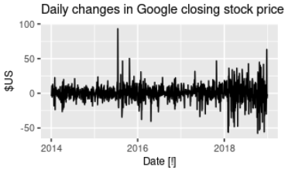
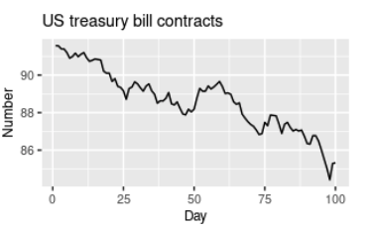
Time Series (Examples)
Example of a stationary timeseries
Example of a nonstationary timeseries
15

Slide 30
Time Series
Every realisation y_1,…y_n can be seen as a series of Random variables
Y_1,...,Y_n.
If the (joint) distribution of Y_1,…,Y_n is known one can predict every
Realisation of these random variables
15

Slide 31
Time Series
Important aspects of the time series are:
Mean:
Mü_t = E(Y_t) = Integral(from –Inf to Inf) y*f_t(y) dx
With t time and mü_t mean of each random variable Y_1,..,Y_n
Covariance:
Gamma(s,t) = Cov(Y_s,Y_t) = E(Y_s-mü_s)(Y_t-mü_t)
Is the covariancefunction. It depends on the two timestamps s and t
Correlation:
Rho(s,t) = gamma(s,t)/sqrt(gamma(s,s)*gamma(t,t))
Is the correlationfunction
15

Slide 32
Time Series
Definition
Linear time series:
Y_t = chi_0 * a_t + chi_1 * a_(t-1) + …
a_t ~ N(0, sigma^2)
t = …,-1,0,1,2,…
Chi_i weights, i = 0,1,2,..
Backshift-Operator:
Bx_t = x_(t-1); Bx_(t-3) = x_(t-4)
B^2x_t=x_(t-2); (1 - B)x_t = x_t – x_(t-1)
(1 - B)^2x_t = (1 – 2B + B^2)x_t = x_t – 2x_(t-1) + x_(t-2)
15

Slide 33
Time Series
Important aspects of the linear time series are:
ACF/Autocorrelation (rho(h)): measurement of information that Y_t provides
To estimate Y_(t+h)
PACF/Partial autocorrelation(tau(h)): Measurement of information that Y_t
Provides To estimate Y_(t+h) given Y_(t+1),..,Y_(t+h-1)
15

Slide 34
Time Series
Different types of time series´s
Moving average models (MA(q))
Autoregressive models (AR(p))
Autoregressive moving average models (ARMA(p,q))
Autoregressive integrated moving average models (ARIMA(p,d,q))
Autoregressive integrated moving average models with seasonal component
(ARIMA(P,D,Q)_s)
15

Slide 35
Time Series
For Example:
AR(p) model is defined by:
Y_t = psi_1 * Y_(t-1) + psi_2 * Y_(t-2) +…+ a_t; t = 1,2,…
⬄ (1 – psi_1 * B – psi_2 * B^2 … ) + Y_t = a_t
AR(1)
Y_t = psi * Y_(t-1) + a_t, t = 1,2,3,…
y_t = b_0 + b_1 * x_t + eps_t
Where b_0 = 0 and x_t = y_(t-1)
15

Slide 36
04
MODEL INTRODUCTION

Slide 37
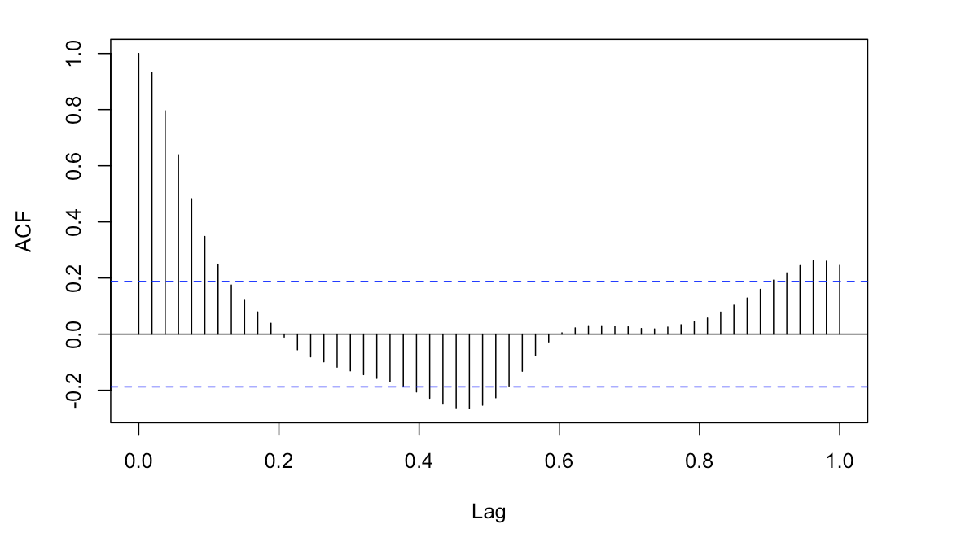
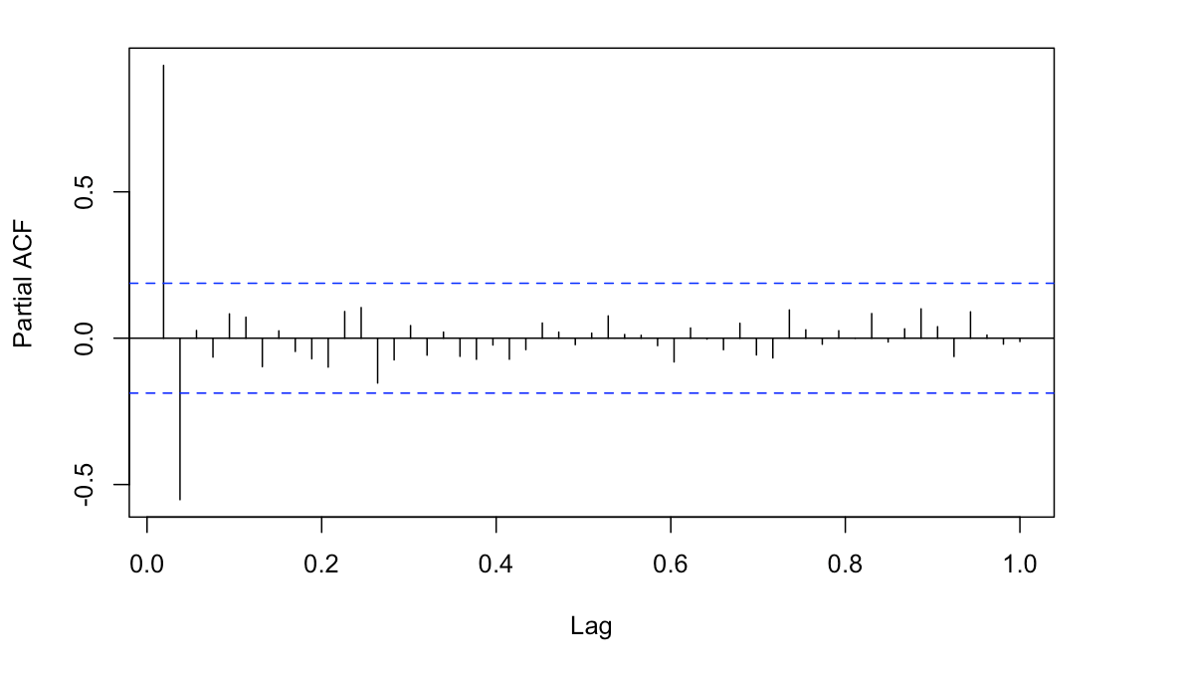
Analyzing ACF and PACF (Bayern)
ACF
PACF
15

Slide 38
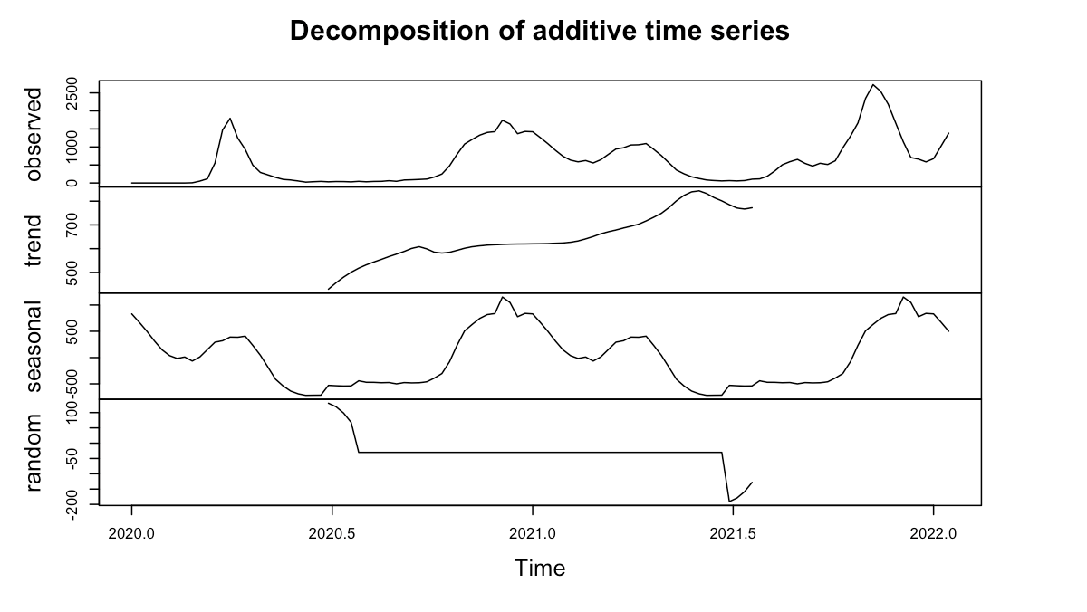
Modeldecision
The time series is not stationary
The time series is seasonal
-> ARIMA(P, D, Q)_s
Using modelselection we receive
ARIMA(0, 1, 1)_53
A
B
15

Slide 39
Modelevaluation (Bayern)
MAPE (Mean Absolute Percentage Error):
Measure of prediction accuracy of a forecasting method
MAPE = 1/n * sum((from t-1 to n) |(A_t – F_t )/A_t|
Where
A_t: true value
F_t: forecast value
MAPE for one week: MAPE for two weeks:
4 % 19.6 %
15

Slide 40
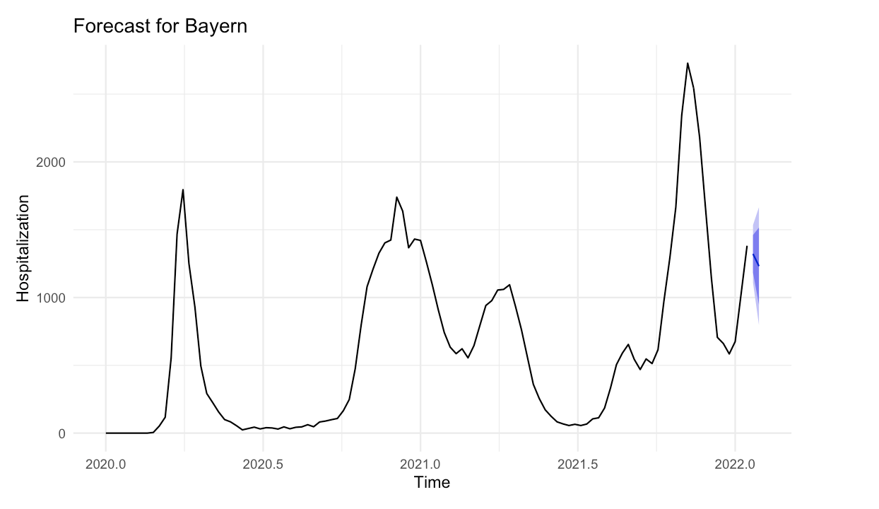
Forecast two Weeks (Bayern)
15

Slide 41
Forecasting result
15

Slide 42
Summary
Difficult to forecast
Infections cannot be accounted for hospitalization
Right now (as of February) there is a clear positive trend
The predictions should be used with care
It is quite likely that the hospitalization won´t follow the current course
There is no information due to anonymity regarding second infections or
hospitalizations
There is still a lot of information missing in univariate timeseries´s which could
Lead to better predictions
There is still information left we cannot receive f.e.
what is the true number of infections
Can people be hospitalized multiple times
What is the exact date of hospitalization
What are possible indicators (illness, smoking etc.)
17

Slide 43
Diskussionsrunde
05

Slide 44
ANHANG
19

Slide 45
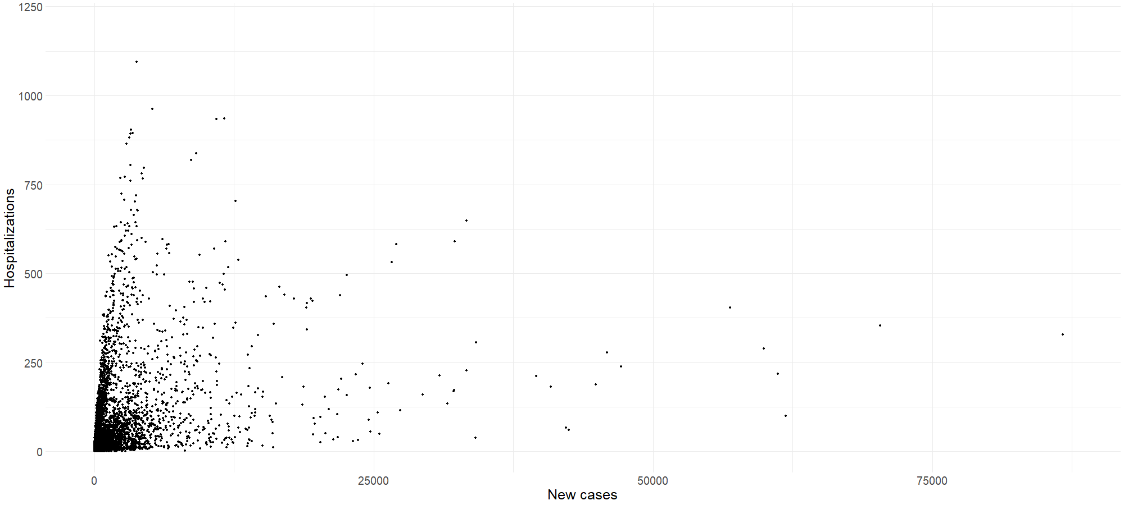
HOSPITALIZATIONS VS. NEW CASES
13

Slide 46
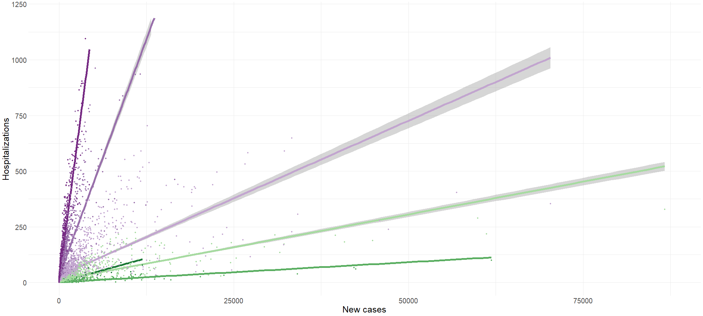

HOSPITALIZATIONS VS. NEW CASES
13

